Slide 1
Distributed Systems
Daniel Andresen
CIS520 – Operating Systems

Slide 2
Distributed systems
…are computing systems composed of large number of CPUs connected by a high-speed network.
A typical computer network connects many hosts, each capable of supplying computing services to network users.
Topologies vary: ring, bus, switch, Internet

Slide 3

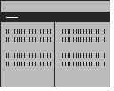
Main idea
Idea: use many distinct but connected computers as single large computational resource
Instead of this.
Use this.

Slide 4
Advantages:
Economics: better price-performance ratio than mainframe.
Resource sharing
Speed: more total computing power than mainframe.
Reliability: if one crashes, system survives. But: partial failures more likely
Scalability: possible to add more nodes.

Slide 5
Disadvantages
Networking: network can be saturated, messages can get lost.
Software: radically different software needed, including operating systems.
Security

Slide 6
Design Issues
Performance-
    - Fine-grained parallelism- jobs that involve a large number of small computation may cause trouble in a distributed system w/ slow communication.
    - Coarse-grained parallelism- jobs involving large computations usually are better for distributed systems.

Slide 7
Scalability
  Avoid
  1. centralized components
    - a single mail server.
  2. centralized tables
    - a telephone book.
  3. centralized algorithms
    - doing routing based on complete information.
  Keep computation/communication ratio high.

Slide 8
Hardware Concepts
SIMD = Single instruction, multiple data
  vector processors, MMX
MIMD = Multiple Instructions, Multiple data.
  All distributed systems, SMP’s.
multiprocessors => have shared memory.
multicomputers => do not have shared memory.

Slide 9
Types of Distributed Systems:
1. bus-based or switched
    bus-based => single cable connecting all machines.
    - switched => individual wires from machine to machine
2. tightly-coupled (shared data) or loosely-coupled (no shared data)

Slide 10
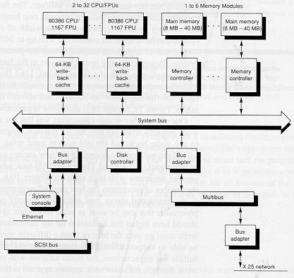
Bus-based multiprocessors
Coherent memory - if X is just written by processor A, then a subsequent read by process B will return the value just written.
To maintain memory coherence:
- write-through cache.
- snoopy + cache - snoops on bus - value written by another CPU => update cache entry or invalidate.

Slide 11
Software
Types of Operating Systems
Loosely-coupled - allow users to be independent, but interact in limited ways.
    - Network Operation System and NFS
2. Tightly-coupled - allow single application to run on several CPU's in parallel.
    - Example: SGI Irix on O2K's

